Slide 1

ANALYZING TRENDS AND CHALLENGES IN CHILDCARE FACILITIES ACROSS ONTARIO
Data –driven report
Presented by: Group 9
Shingala, Aniket
Sathyamurthy, Roshan
Parmar Kaushal
Kanojia Saurabh
DATE :- 09-08-2024

Slide 2

Executive summary
This study looks at Ontario Open Data Portal data to understand the current state of childcare facilities across Ontario as of June 2024.
The goal is to find patterns, understand what affects the availability of childcare, and identify any issues that need attention.
The study addresses key questions, such as the regional spread of childcare facilities, differences in their operating status across areas, and the factors that might be causing these variations.

Slide 3
Problem Statement
“ The main issue is that not all families in Ontario have equal access to good quality childcare. Some areas have fewer childcare centers, and there aren't enough services available in French. Additionally, some childcare centers have stopped operating, which reduces options for parents. “

Slide 4

Retrieving Data or Data Source
Data Source: The information was gathered via Ontario’s open data portal, which offers publicly accessible databases on several subjects, including childcare establishments.
Metadata: Detailed explanation of the key variables in the dataset, such as:
Facility Name: Name of the childcare facility.
City: The city where the facility is located.
Postal Code: Postal code for location-based analysis.
Status: Operational status of the facility (open/closed).
Licensed Capacity: The number of children the facility is licensed to accommodate.
Region: Regional classification for broader geographical analysis.

Slide 5
Data Preparation and Cleaning: Gathered data from Ontario's Open Data Portal, ensuring it was accurate and ready for analysis.
Data Cleaning:- Removed duplicates, handled missing values, and standardized the data to ensure consistency.
Trend Analysis: Explored trends in childcare services over time using simple data visualization techniques in Tableau.
Regional Insights: Analyzed how childcare centers are distributed across different regions, focusing on gaps and areas needing improvement.
License Dynamics: Investigated the operational status of centers to understand the reasons behind active and inactive licenses.

Slide 6
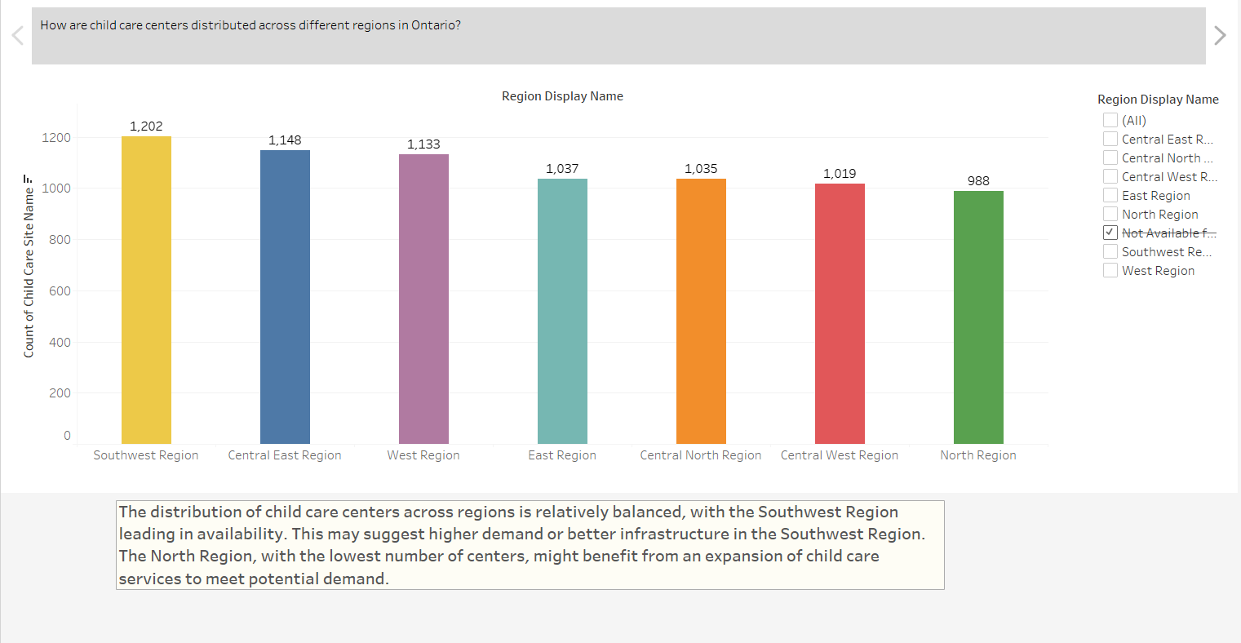
Data Exploration
Data Exploration
Total Child Care Centers by Region

Slide 7
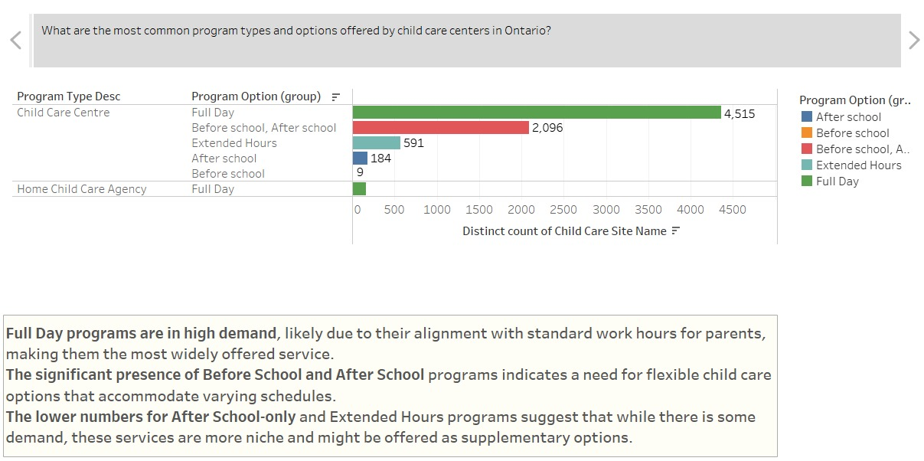
Number of Child Care Center with different Program Types and Program Option

Slide 8
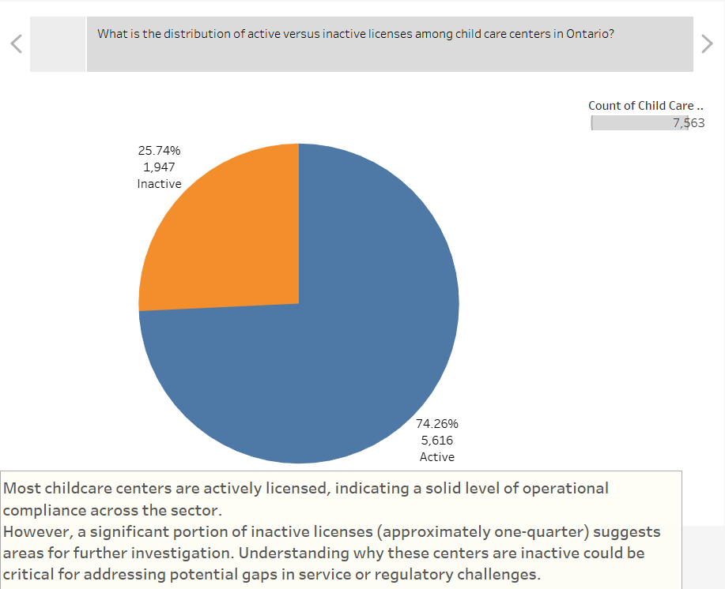
Data Exploration
License Status Distribution of Child Care Center

Slide 9
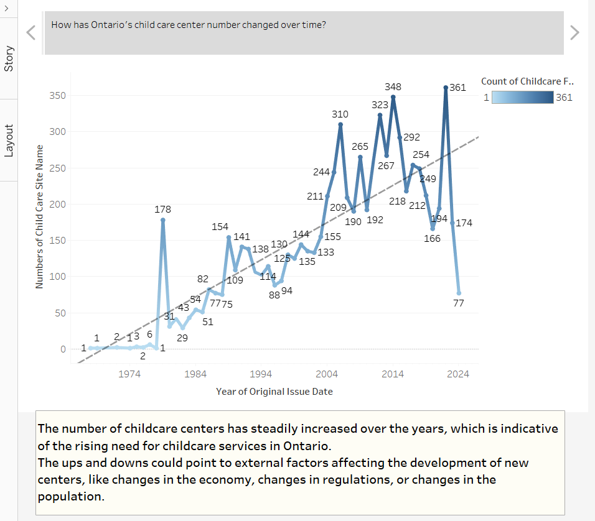
Data Exploration
Number of Child Care Center Over Time

Slide 10
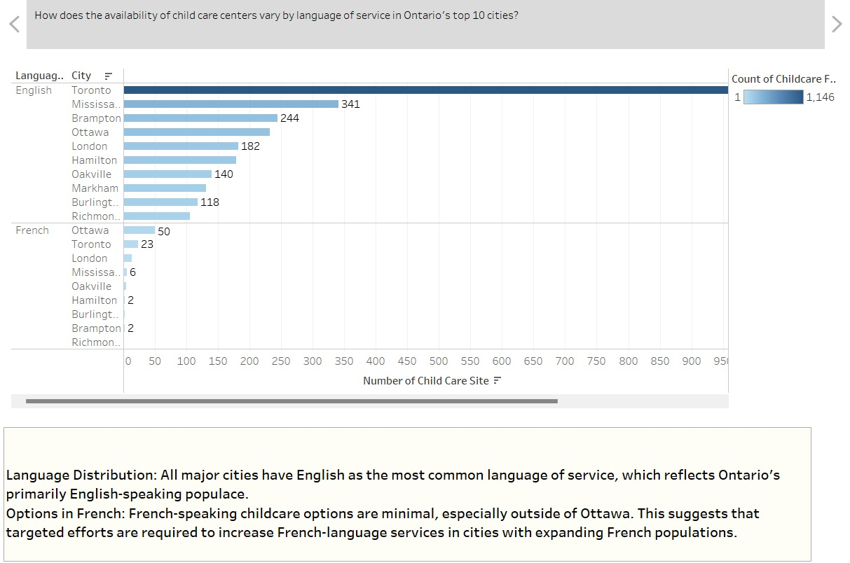
Data Exploration
Top 10 cities by the number of child care centers by Language

Slide 11

Summary of Key Recommendations
Expand Childcare Services: Increase the number of centers in regions with fewer facilities.
Enhance Language Accessibility: Boost availability of French-language services, especially in areas with Francophone populations.
Support Active Centers: Provide resources to help more centers stay operational.
Improve Licensing Compliance: Simplify and support the licensing process to ensure more centers remain active.

Slide 12
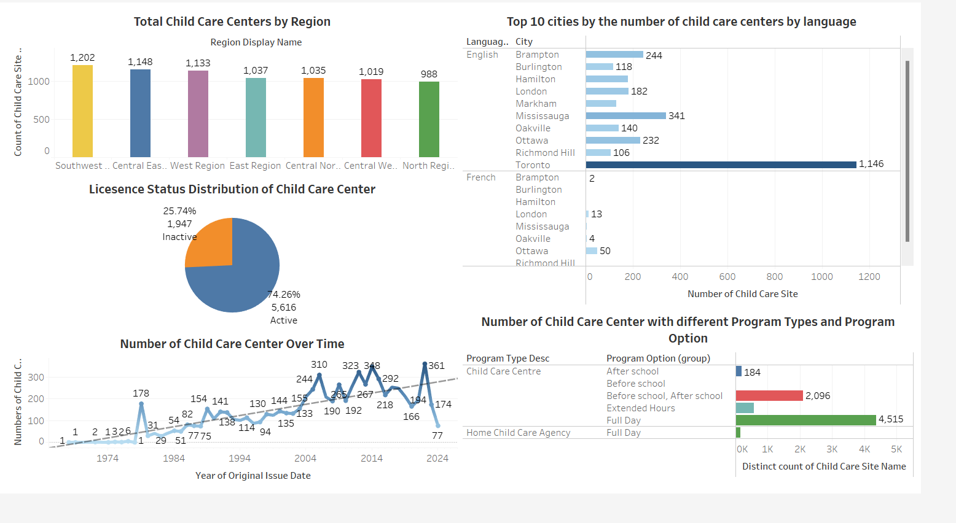
Appendix : Dashboard: https://public.tableau.com/app/profile/kaushal.parmar6141/viz/S24Group9Childcarefacilitiesincanada/Dashboard1?publish=yes

Slide 13
Conclusion
This report highlights key issues in Ontario's childcare services, such as unequal access across regions, limited French-language options, and fluctuating numbers of active centers.
To improve, we recommend focusing on expanding services in underserved areas, enhancing language accessibility, and supporting more centers to stay operational.
These changes will help ensure that all families in Ontario have access to reliable and high-quality childcare.

Slide 14

Thank You

